Slide 1
Searching for new locations
Bangkok Thailand

Slide 2
FamilyMart – Japan 2nd largest convenient store

Slide 3

Franchise: Bangkok Thailand

Slide 4

Searching for potential location
Clustering neighborhood in Bangkok
Competitor analysis
7-Eleven stores in the neighborhood
Explore each cluster for potential customer
Identify interesting cluster and neighborhood with low number of 7-Eleven stores

Slide 5
Data acquisition and cleaning (Total of 4788 rows and 250 Features)
50 Bangkok neighborhood name and location - Wikipedia
Neighborhood area to calculate neighborhood radius – BKK DB
Numbers of 7-Eleven store in each neighborhood -Foursquare
Nearby venue categories -Foursquare

Slide 6

Data cleaning

Slide 7
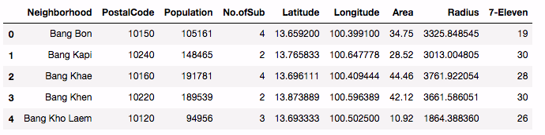
Bangkok neighborhood information

Slide 8
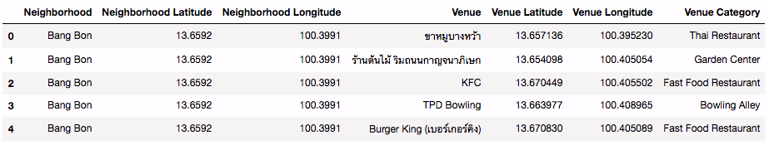
Nearby venue examples

Slide 9
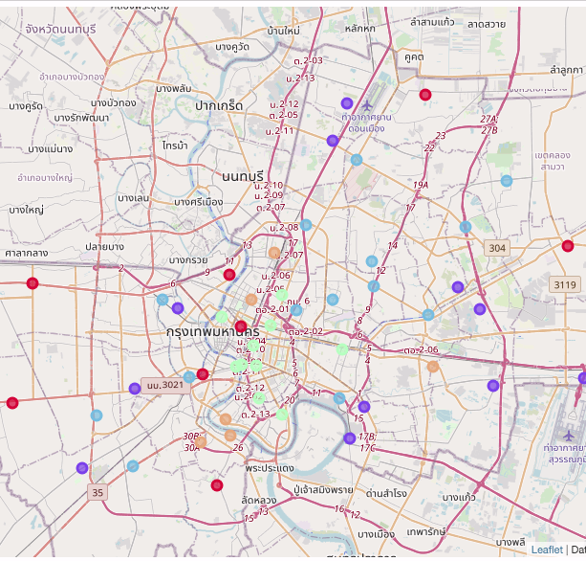
Clusters result
Center of convenient stores, Thai restaurants and noodle houses
Mixed area of coffee shop, convenient store and Thai restaurant
Heaven for noodle lovers and coffee shop hoppers
Tourist district
Hotpot hotspot

Slide 10
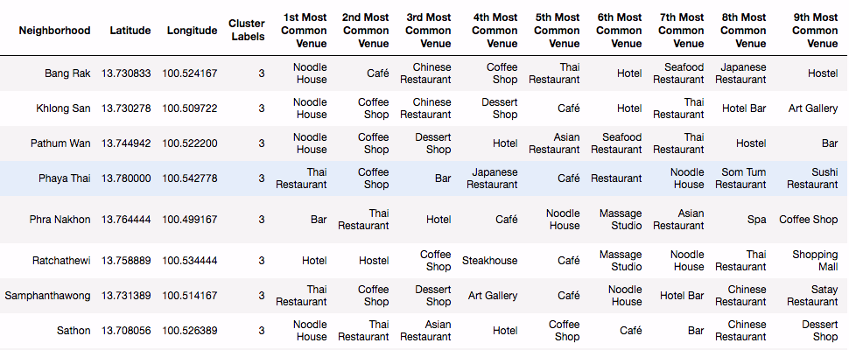
Tourist District analysis
*** No convenient store in common venue

Slide 11

Number of 7-11 stores in Tourist District neighborhood

Slide 12
Conclusion and Future direction
Utilize Kmeans clustering to analyze Bangkok neighborhood and identify potential location for a new FamilyMart store
Tourist District was recommended for a new store from clustering result
Sampanthawong is an interesting neighborhood as it has lower number of existing competitor stores
Future direction
Analyze no. of populations per convenient store in each neighborhood
Pinpoint a sub-neighborhood in Sampanthawong neighborhood as a new location for the new FamilyMart store

